Slide 1
INTRODUCTION TO DATA VISUALIZATION

Slide 2


AUDIENCE
The analysis is prepared for the Canadian Council of Forest Ministers, other government and non-government bodies concerned with forest fires and climate change.

Slide 3
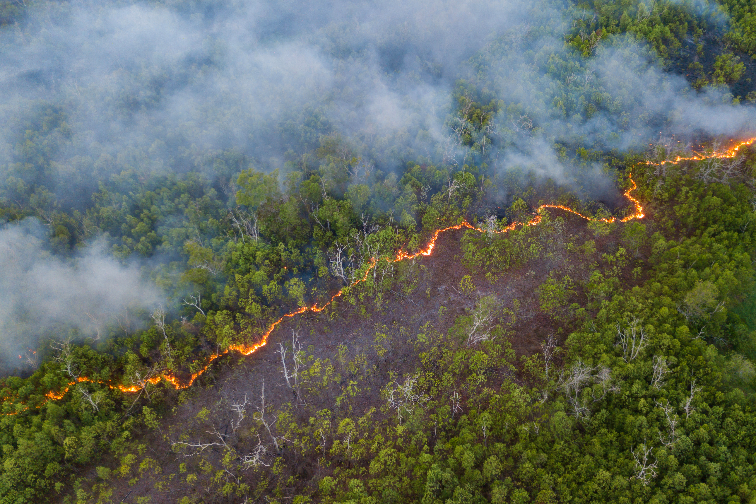
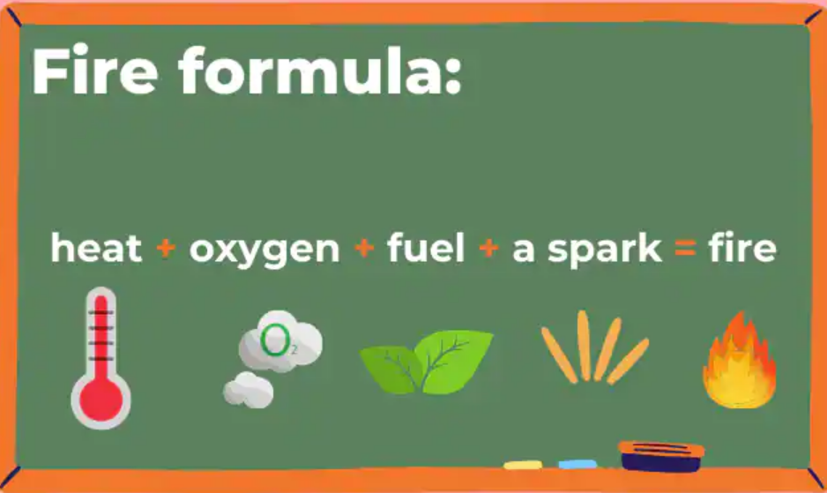
INTRODUCTION
According to a Canadian daily, a senior citizen from British Columbia, has been facing an underlying condition of asthma, which the doctors said was due to smog caused by wildfires.
The objective of the study is to identify the main causes of forest fires and its impact on various parts of Canada.

Slide 4
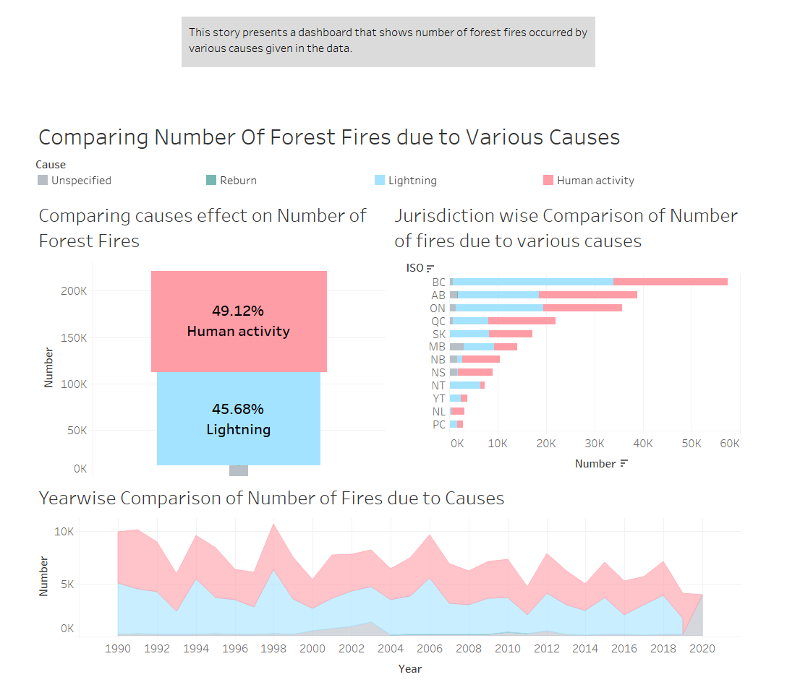

Slide 5
The give story point represents a dashboard which shows the number of forest fires occurred by various causes given in the data.
The 1st graph is the funnel graph which shows comparison between the number of forest fires due to various causes.
The number of forest fires caused by human activities and lightening are approximately the same. As you can see the percentage of number of forest fires caused by human activities is 49.13% and due to lightening is 45.69% which are almost similar.
The 2nd and 3rd graph represent the jurisdiction-wise and year-wise comparison of the same respectively.
The dashboard is used to highlight and filter the causes and see the number of forest fires in the selected jurisdiction and year.

Slide 6
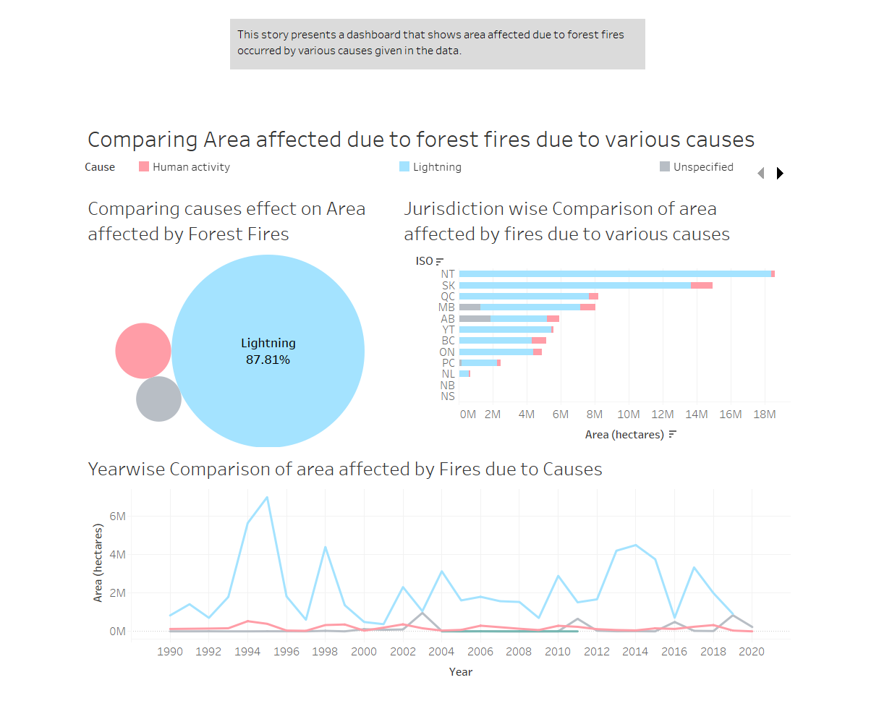

Slide 7
This story point representing a dashboard, and it shows the area affected by forest fires occurred due to various causes given in the data.
The 1st graph is the bubble graph which shows comparison between the area affected by forest fires due to various causes.
It shows the impact caused by lightening is significantly more as the area affected is the most. As it can be seen the percentage of area affected by human activity is only 7.34% while that of lightening is 87.81% which is notably high.
The 2nd and 3rd graph represent the jurisdiction-wise and year-wise comparison of the same respectively.
The dashboard is used to highlight and filter the causes and see the area affected due to forest fires in the selected jurisdiction and year.

Slide 8
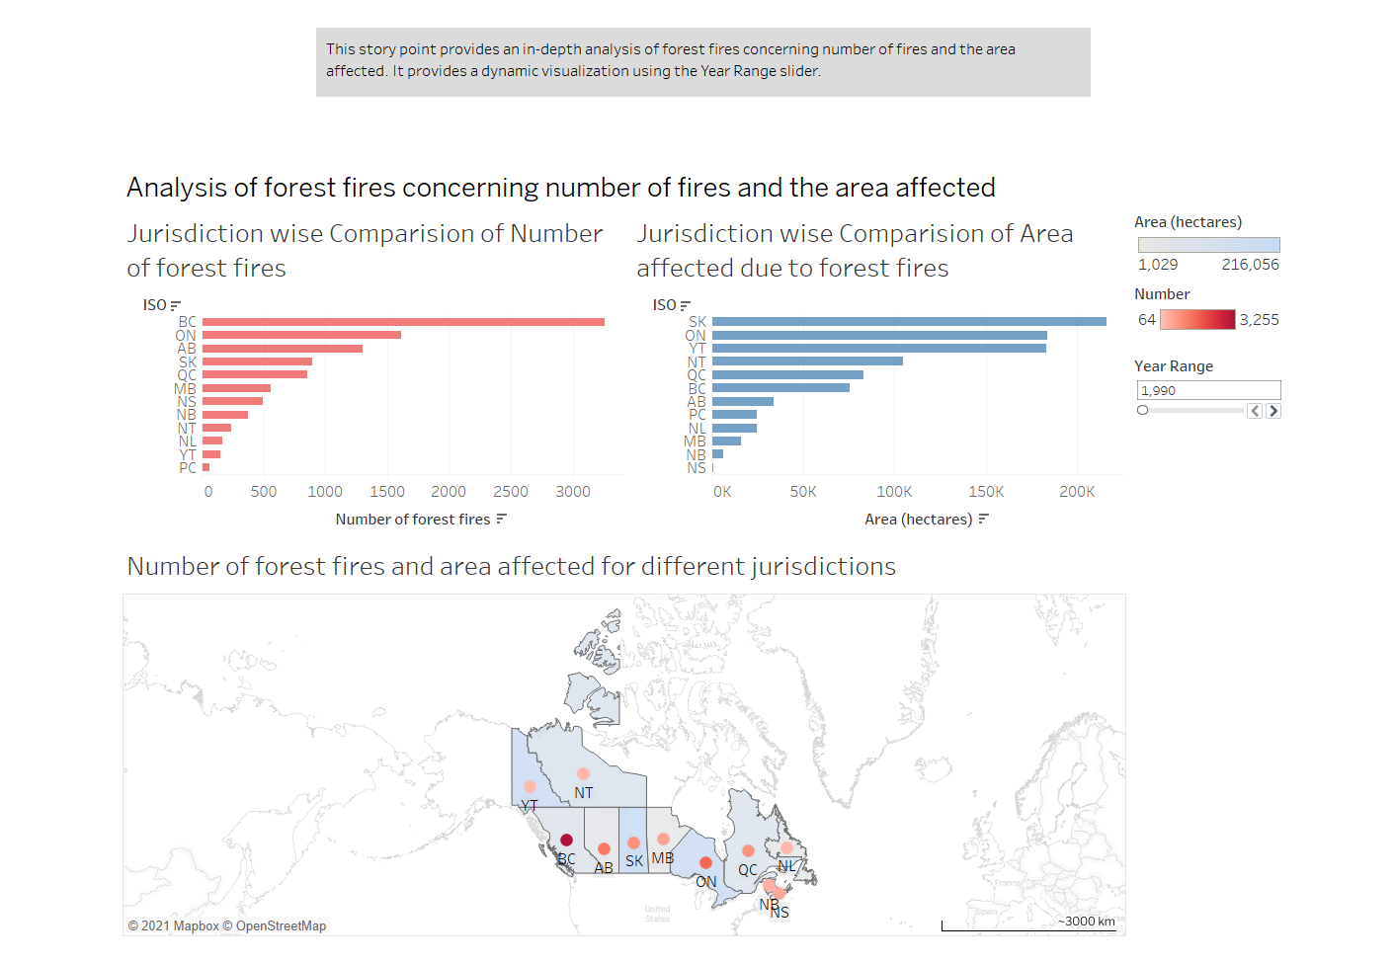

Slide 9
The story point is a dynamic visualization and uses a slider for selecting a year. If we select a particular year from the slider, the graph shows data pertaining to the selected year. The dashboard is used to filter the observations by highlighting the selected parameter.
It provides an overall picture from a geographical perspective depicting number of forest fires and area affected. The main purpose of this story point is to give an overview of the forest fire situation in Canada for the period under consideration.
The map illustrates the number of fire incidents that have taken place in respective jurisdictions of Canada along with the area affected due various causes of fire, from 1990 to 2020.
It can be seen that the most fire incidents have occurred in BC (British Columbia) whereas in terms of area affected NT (Northwest Territories) stands ahead of all other jurisdictions.

Slide 10
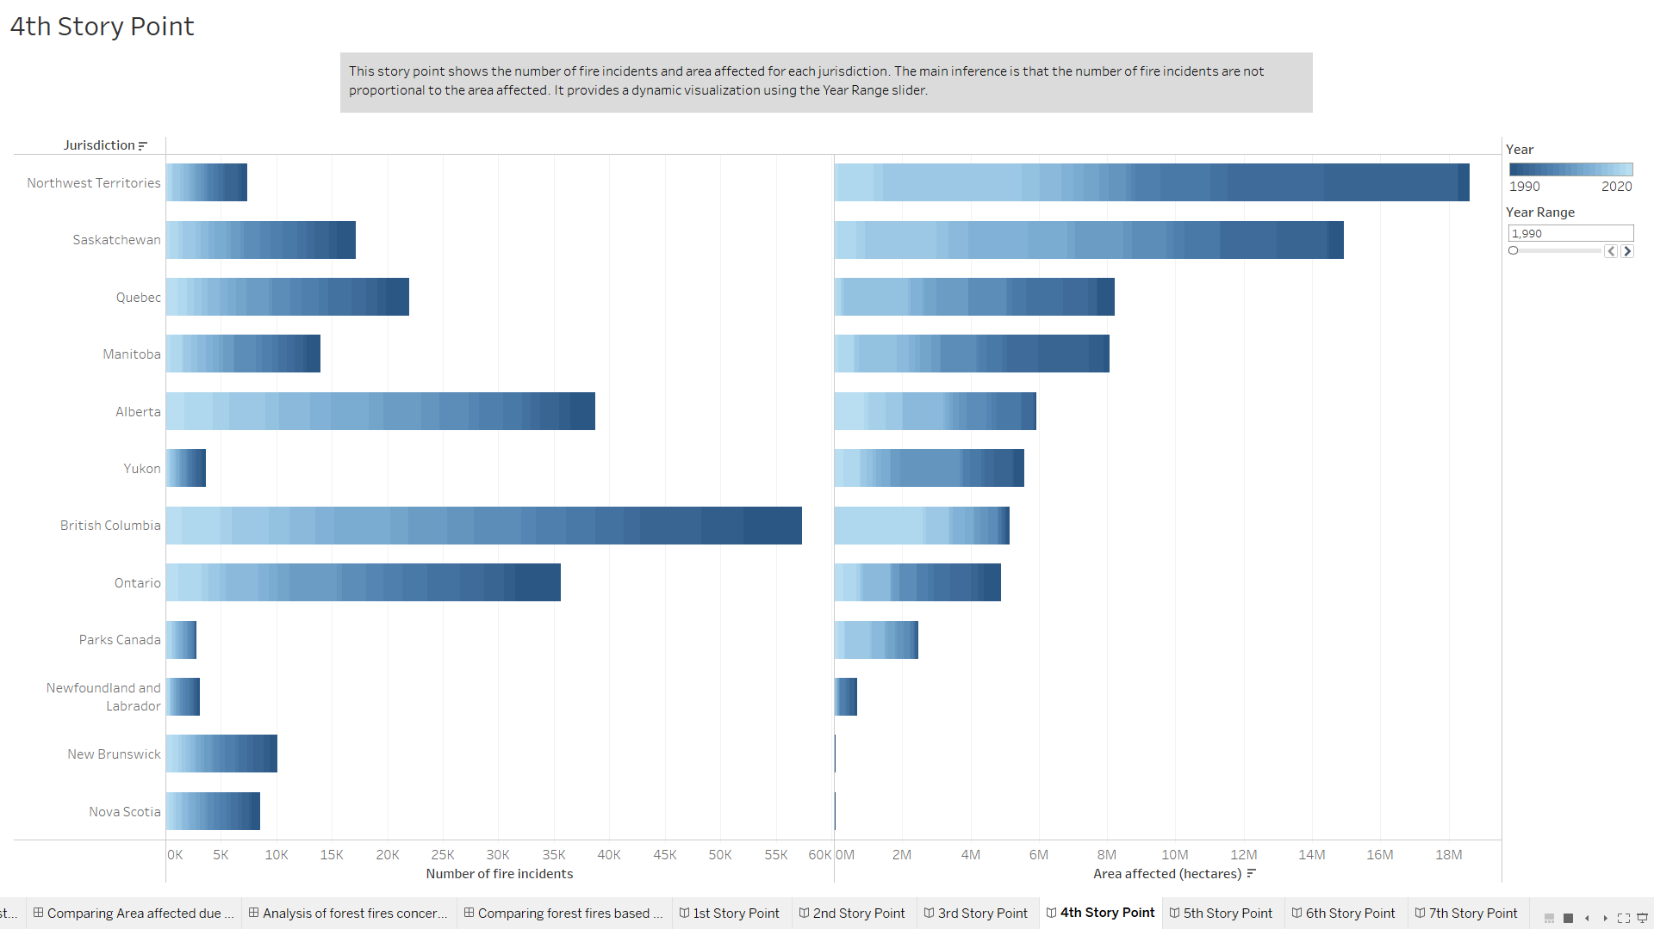

Slide 11
The visualization on the previous slide depicts information about number of forest fires and area affected for various jurisdictions and the visualization in following slide gives information regarding forest fires in Northwest Territories and British Columbia for a period from 1990 to 2020.
The number of fire incidents is not proportional to the area affected.
For example, the number of forest fires in Northwest Territories is quite low; however, the area affected is the most.
Similarly, British Columbia experienced the highest number of forest fires; however, the area affected was comparatively less.
The same can be clearly seen from the following visualization as well.

Slide 12
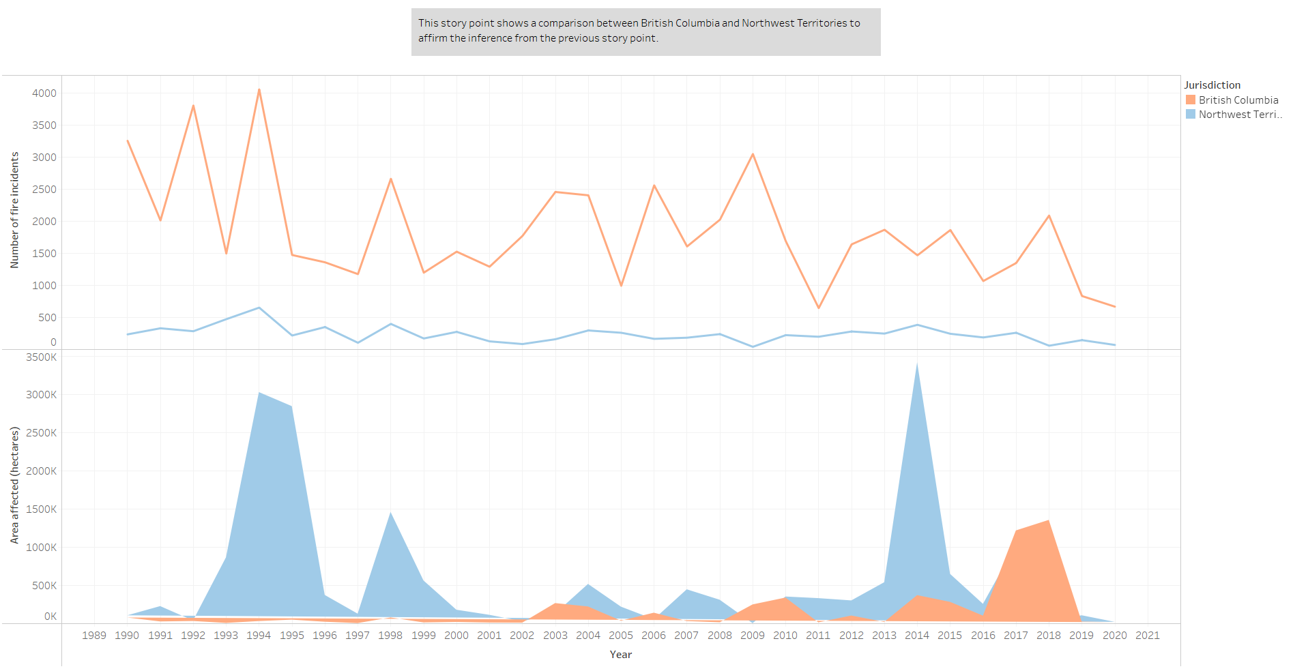

Slide 13
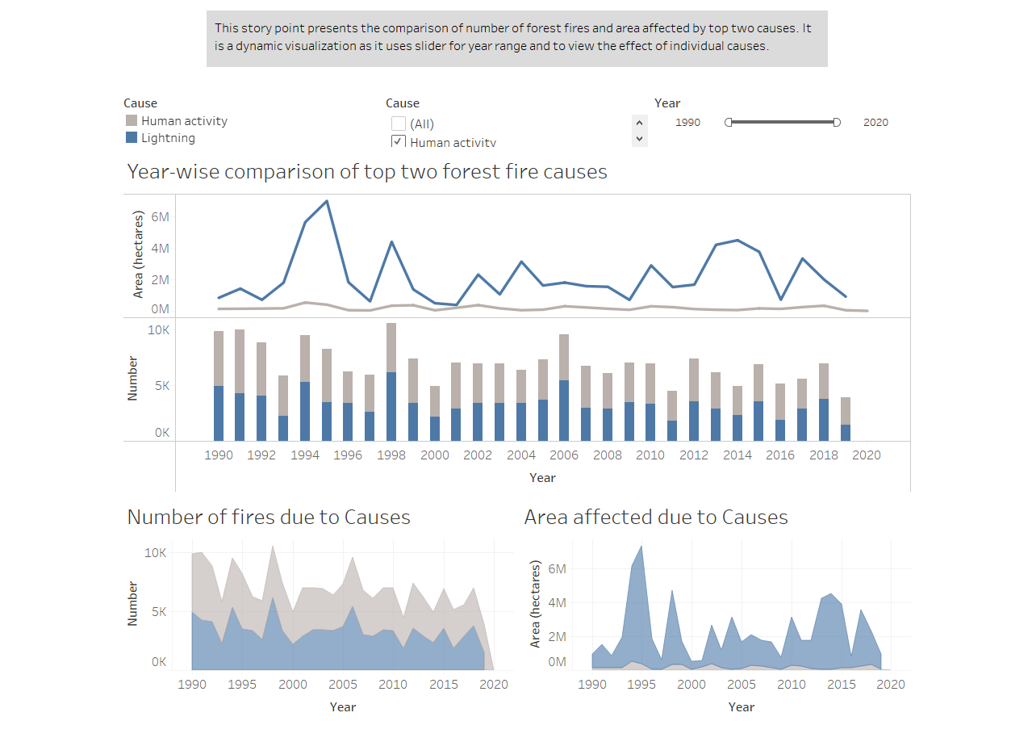

Slide 14
The story point represents a dashboard which presents the year-wise comparison of number of forest fires and area affected by top two causes. This story point also provides a dynamic visualization as it uses a slider for year range and to view the effect of individual causes. The dashboard is used to highlight and filter the data based on year range and causes
In terms of area affected, significantly more area is affected due to lightning as compared to human activity. Area affected by human activity had been almost constant all through the given time period whereas a lot of variation can be seen in case of lightening.
The year with the highest area burned was 2014, with about 4.5 million hectares (ha) and the year with the smallest area burned was 2009, with about 800,000 ha.
In terms of number of fire incidents, numbers are relatively same for both human activities and lightning.
In 2019, there were about 4,000 forest fires, the smallest annual number of fires since 2009 and the highest number of wild land fires occurred in 2012, with about 8,000 fires.

Slide 15
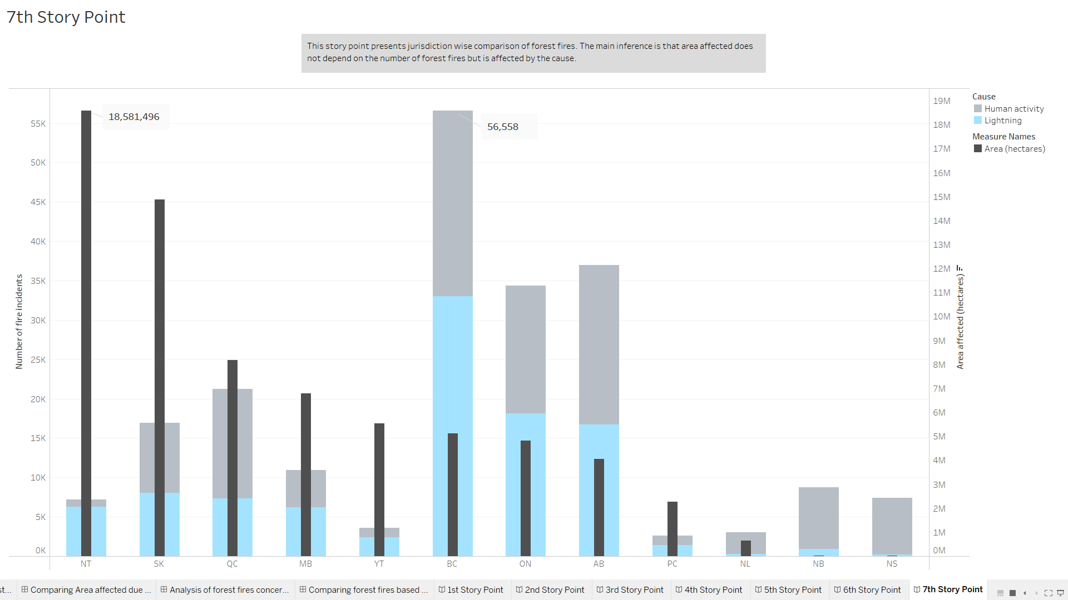

Slide 16
For any given jurisdiction, the area affected due to forest fires is not proportional to the number of fire incidents but depends on the cause of forest fires.
Area affected is greater for province where proportion of forest fires due to lightening is more than fire incidents due to human activity.
Majority of fire incidents in Northwest Territories jurisdiction between 1990 and 2020 were due to lightening.
Major proportion of forest fires in Nova Scotia and New Brunswick between 1990 and 2020 were result of human activities.
Area affected due to fire incidents between 1990 and 2020 is greatest for Northwest Territories and least for New Brunswick and Nova Scotia.

Slide 17
CONCLUSION
There is no relation in number of forest fires and area affected in various jurisdictions of Canada for the period between 1990 and 2020.
Number of forest fires caused by human activities and lightening are approximately the same.
The impact caused by lightening is significantly more as the area affected is the most.

Slide 18
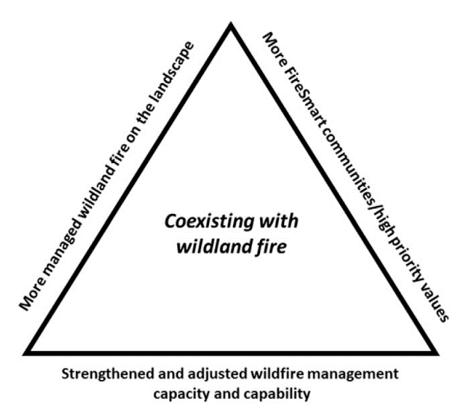
RECOMMENDATIONS
Enhance firefighting capacity which includes strategic resource management
Renewing critical assets
Maintaining or replacing critical infrastructure
Developing innovative solutions to overcome human resource challenges
Departments should combine efforts to attain shared goals
Enhance commitment to Fire Smart and increase preparedness capacity

Slide 19
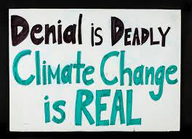
THANK YOU

